Slide 1
KeywordPulse
SEO Keyword Tracker and Analyzer
Team 3 - Algo Wizards
CPSC 535: Advanced Algorithms (Fall 2023)
Project 3

Slide 2
Team Members & Roles
GUI Developers - James Kim & Tejashwa Tiwari
Algorithm Specialists - Param Venkat Vivek Kesireddy, Pravallika Bahadur & Rishitha Bathini
Testing & Analysis Expert - Anthony Martinez
Designing & Planning Heads - Param Venkat Vivek Kesireddy & Anshika Khandelwal
Documentation Lead - Rishitha Bathini
Project Coordinator - Tejashwa Tiwari

Slide 3



Software Development & Project Management
We used Kanban Board & GitHub - They offer a complete solution for software development teams, enabling team members to work more productively, maintain order, and produce high-quality software.

Slide 4
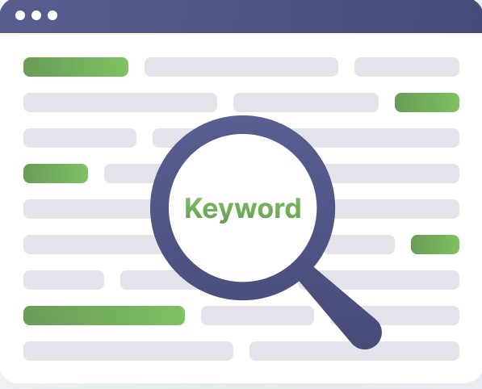
Introduction
The "SEO Keyword Tracker and Analyzer" project is an innovative initiative with the goal of revolutionizing the tracking and analysis of SEO keywords within website content.
With the help of the "SEO Keyword Tracker and Analyzer" project, users can precisely analyze keyword performance, enabling data-driven decisions to enhance their online visibility and engagement.

Slide 5

Objective & Overview
The SEO Keyword Analyzer utilizes a Flask (Python) backend for its core functionality and a React.js framework with the Material UI design library for its user-friendly front-end interface. It integrates a variety of cutting-edge sorting algorithms and charting libraries to visualize keyword extraction efficiency. The Flask server, responsible for serving the static build generated by the React app, is run on local.

Slide 6
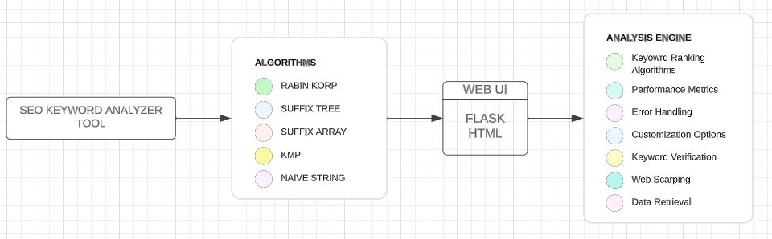
Visual Model

Slide 7

Target Users
Use Cases
The SEO Keyword Analyzer is designed for digital marketers, webmasters, content creators, and SEO specialists seeking to optimize their online content and improve search engine rankings.
Content Optimization
Keyword Research
Competitor Analysis
SEO Strategy Improvement
Web Page Visibility Assessment
Data-Driven Decision-Making
Keyword Monitoring
Online Marketing Campaigns

Slide 8
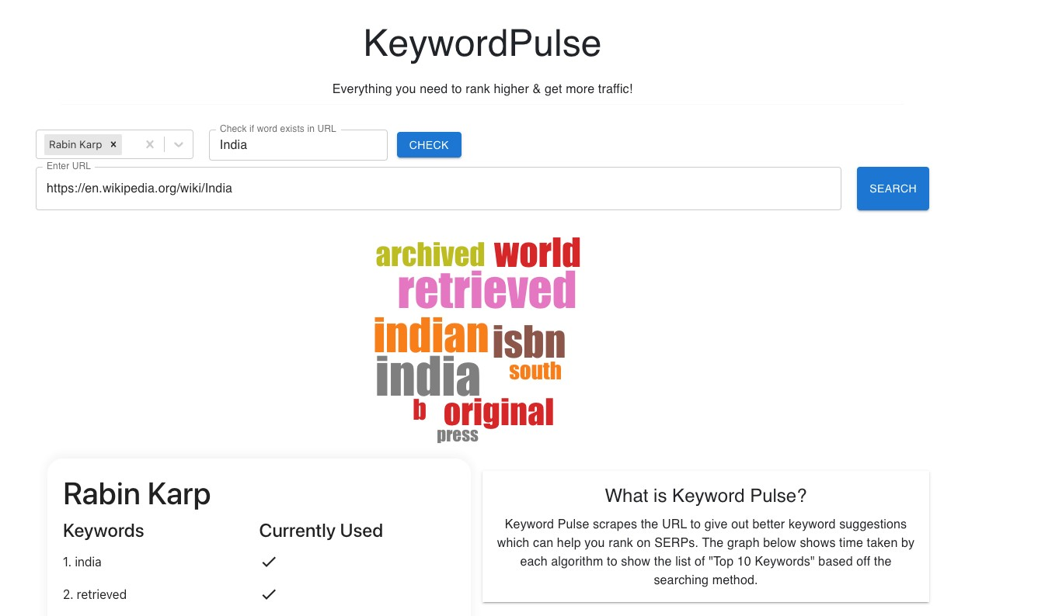
User Interface

Slide 9
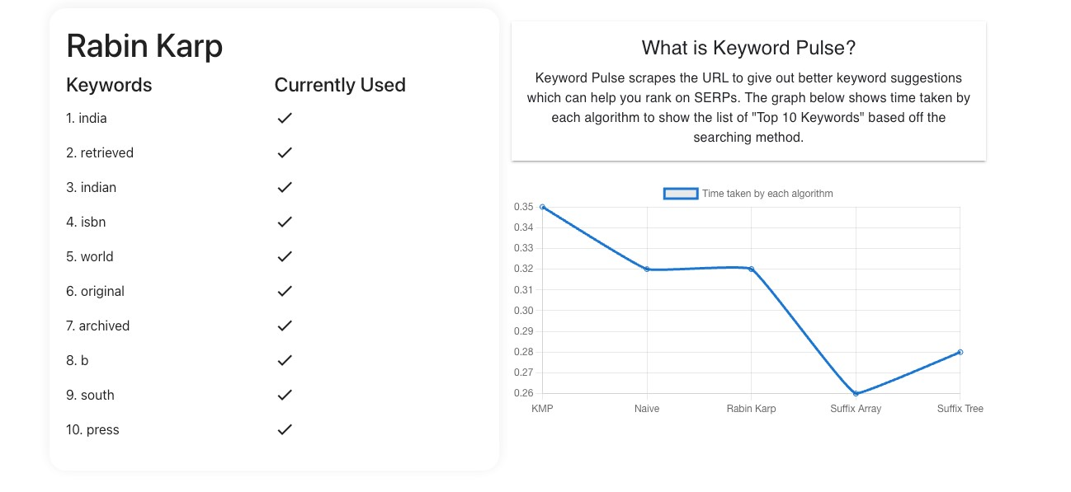

Slide 10
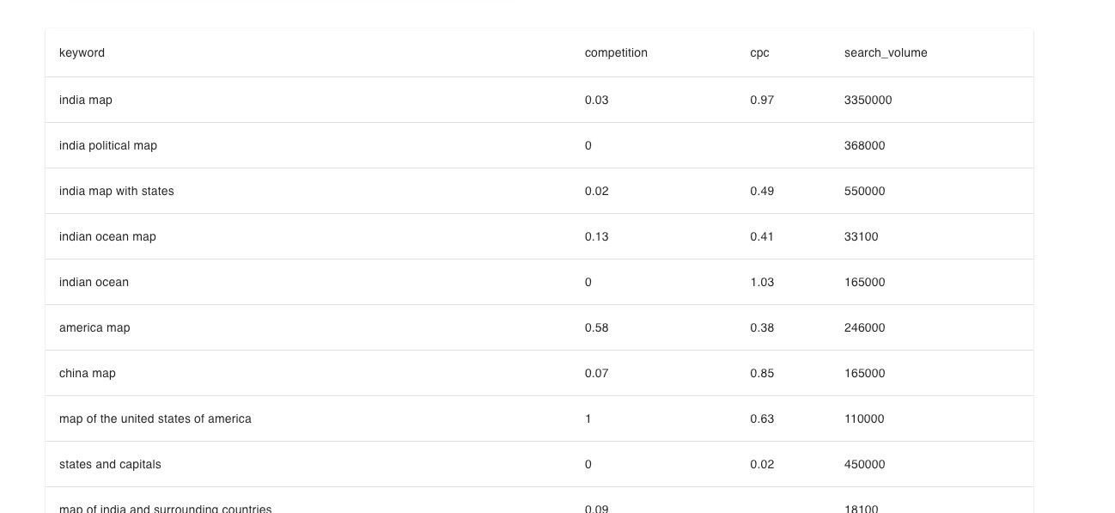

Slide 11
Methodology
The available algorithms include:
KMP (Knuth-Morris-Pratt): This algorithm efficiently searches for keywords within text and is particularly suited for finding exact matches.
Naive Keyword Extraction: This method extracts keywords based on word frequency in the text.
Rabin-Karp: This algorithm employs hashing techniques to search for keywords in text, making it suitable for partial and approximate keyword matching.
Suffix Array: Suffix arrays are used for substring searching in a text efficiently. They can quickly locate all occurrences of a pattern in the given text.
Suffix Tree: Suffix trees allow for efficient substring search in a given text. They can determine if a particular string is a substring of the given text in O(m) time, where m is the length of the substring to be searched.

Slide 12
Testing
1. Unit Testing: Evaluated individual components and algorithms to ensure functionality.
2. Integration Testing: Verified seamless collaboration among user interface, algorithms, and data processing.
3. Functional Testing: Assessed the tool's alignment with its functional requirements and criteria.
4. User Testing: Obtained valuable user feedback on user experience, data input, and result interpretation.
5. Performance Testing: Measured tool responsiveness and efficiency in handling varying data volumes.

Slide 13

Challenges
Creating the "SEO Keyword Tracker and Analyzer" project involved overcoming specific challenges, including the integration of five distinct algorithms.
Implementing and coordinating five different algorithms for keyword tracking and analysis demanded careful planning and precise execution.
Ensuring the tool remained easy to use while incorporating multiple algorithms was a balancing act, requiring an intuitive user interface.
Guaranteeing the accuracy of each algorithm's performance was vital. Rigorous testing and debugging were conducted to iron out any algorithmic errors.

Slide 14

Conclusion
To sum it up, our SEO Keyword Tracker and Analyzer project is a game-changer for SEO tasks. It offers a user-friendly tool that empowers digital marketers, webmasters, and content creators with valuable keyword insights.
It simplifies SEO strategies and boosts online visibility. With its user-friendly features, potential for enhancements, and diverse applications, it becomes a crucial asset in the realm of digital marketing.

Slide 15
Thank you! Any Questions?
Group 3 - Algo Wizards
Anthony Martinez | James kim
Anshika Khandelwal | Pravallika Bahadur
Tejashwa Tiwari | Rishitha Bathini
Param Venkat Vivek Kesireddy

